Slide 1
uConnect Hackathon 2024
AI Powered Anomaly Detector
TEAM Achievers
Renuka Saraf
Rohit Gadekar
Gopalkrushna Kolhe

Slide 2

Agenda
Problem Statement
Innovation and Thinking
Business Value
Architecture Diagram
User Interface
Distinctive Features
Solution Demo
Future Scope
Team Photo

Slide 3

Problem Statement
Write Anomaly detection for Windows/Linux Unstructured file data or NAS file server that analyses unusual user activity and user behaviour.
User behaviour is represented as any user actions performed on the system. Consider using capabilities of File Change Log, API usage, Audit logs, WORM, CPU usage, and unusual disk activity.
Leverage AI/ML techniques. Understand different attack patterns and resemble to actions carried out. The algorithm should demonstrate accuracy and consider false positives and false negatives.

Slide 4

Innovation & Thinking
Breaking Boundaries: From Logs to Real-Time Insights
Evolution: Started with generated system logs analysis.
Incorporation of Real-time Data: Now incorporated real-time data including CPU usage, disk space, and memory usage.
Uniting Diverse Data Streams: Gave options of anomaly detection on Log File, Real time data and CSV file.

Slide 5

Business Value
Fraud Detection: Preventing unauthorized access and data breaches, e.g., detecting unusual file downloads.
Fraud Detection in Credit and Debit card usage.
Healthcare Analysis: Ensuring patient data security, e.g., monitoring abnormal access to medical records.
Special use case in ECG Monitoring
Industry Quality Control: Enhancing operational efficiency, e.g., detecting anomalies in manufacturing processes.
Detecting Memory leaks and abnormal CPU Usage.
IOT System Monitoring.

Slide 6
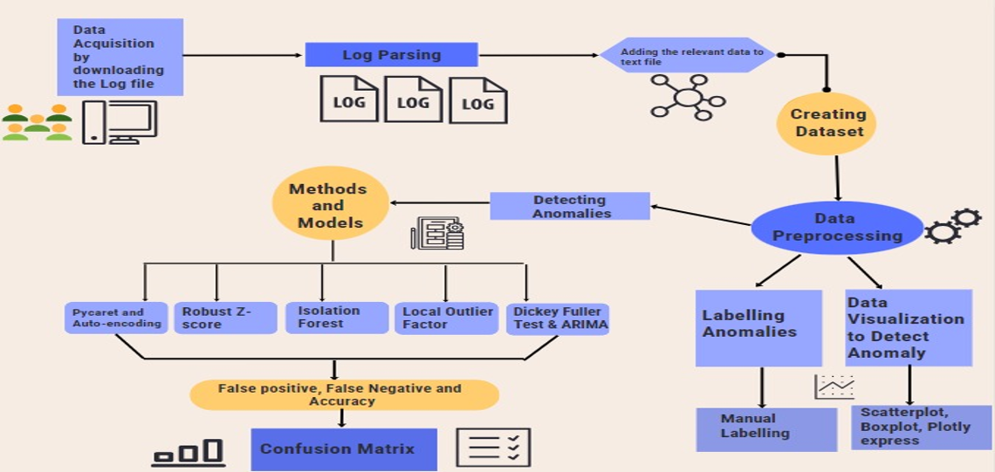
Architecture Diagram

Slide 7
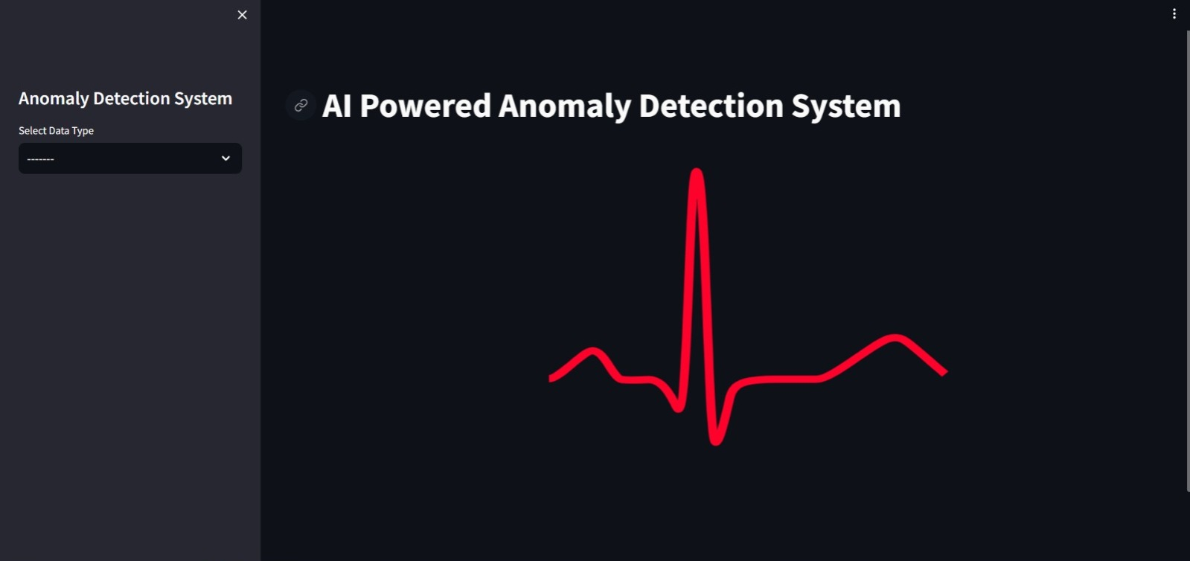
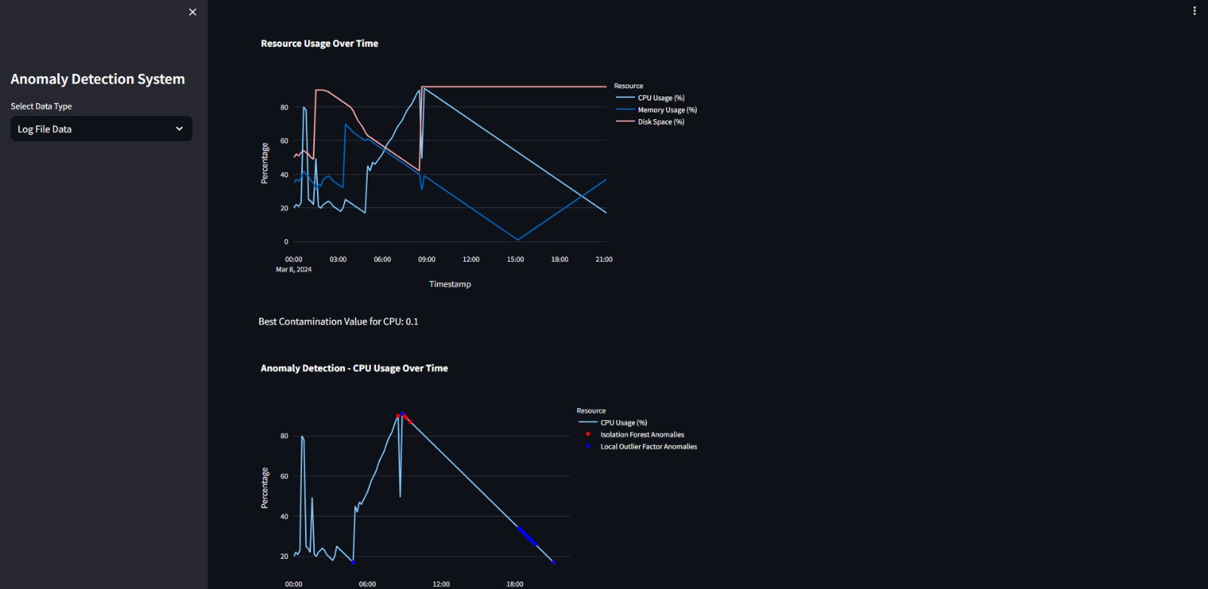
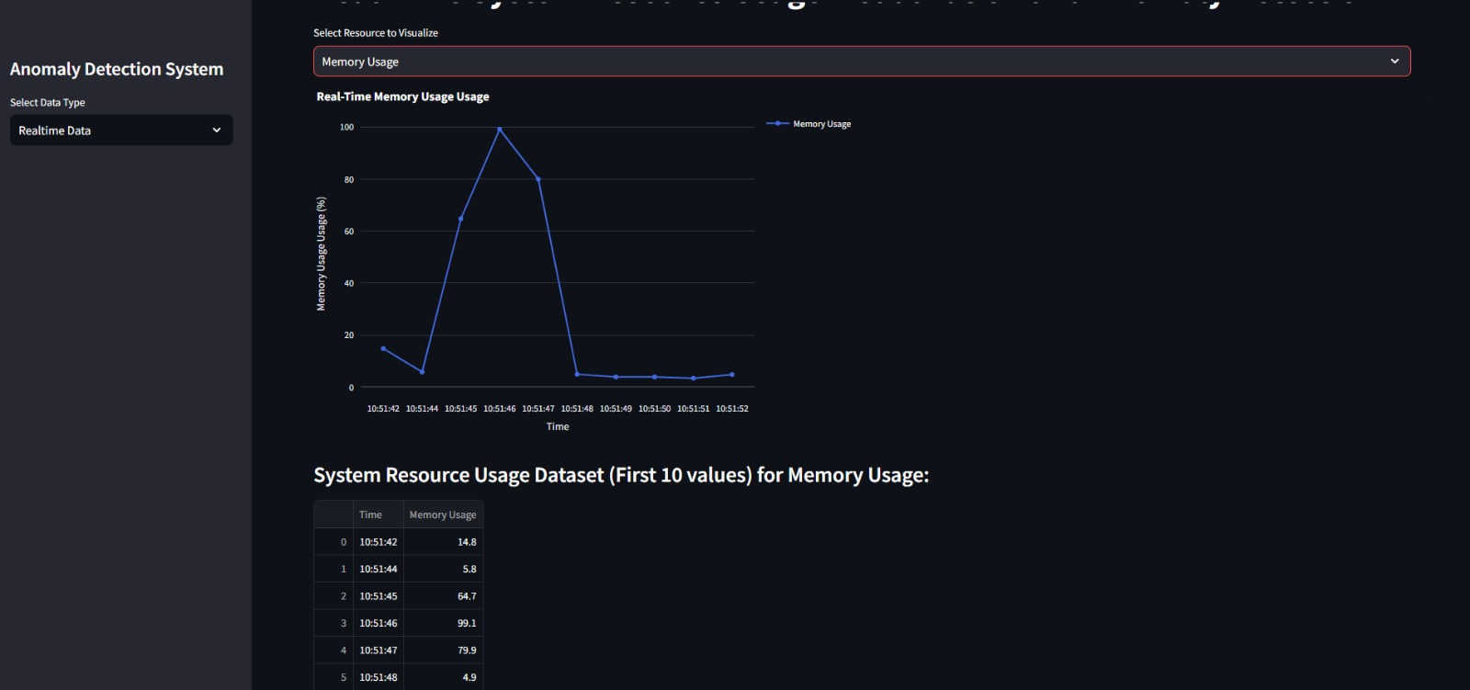
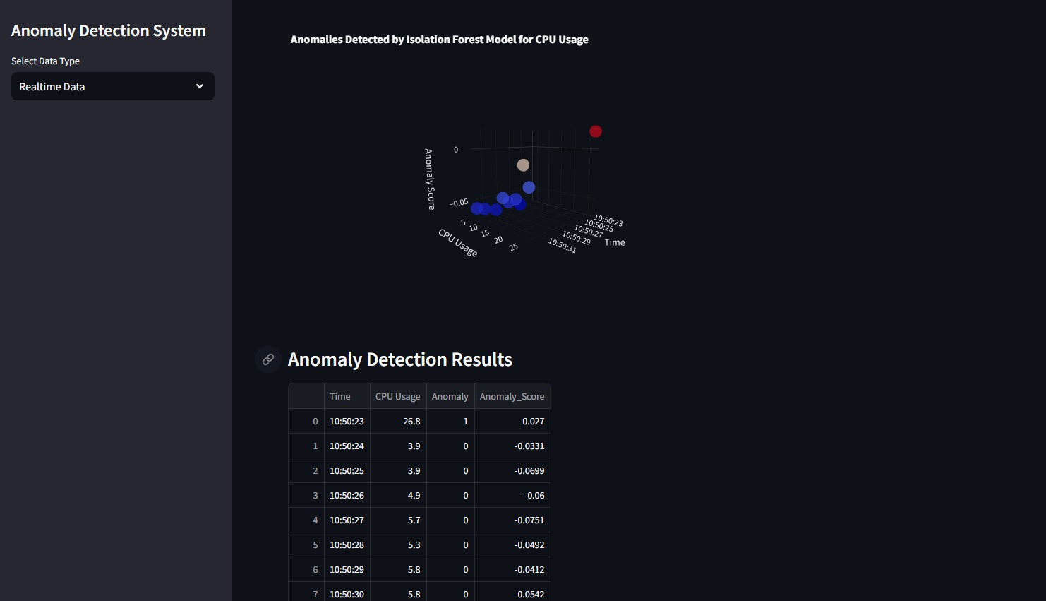
User Interface

Slide 8
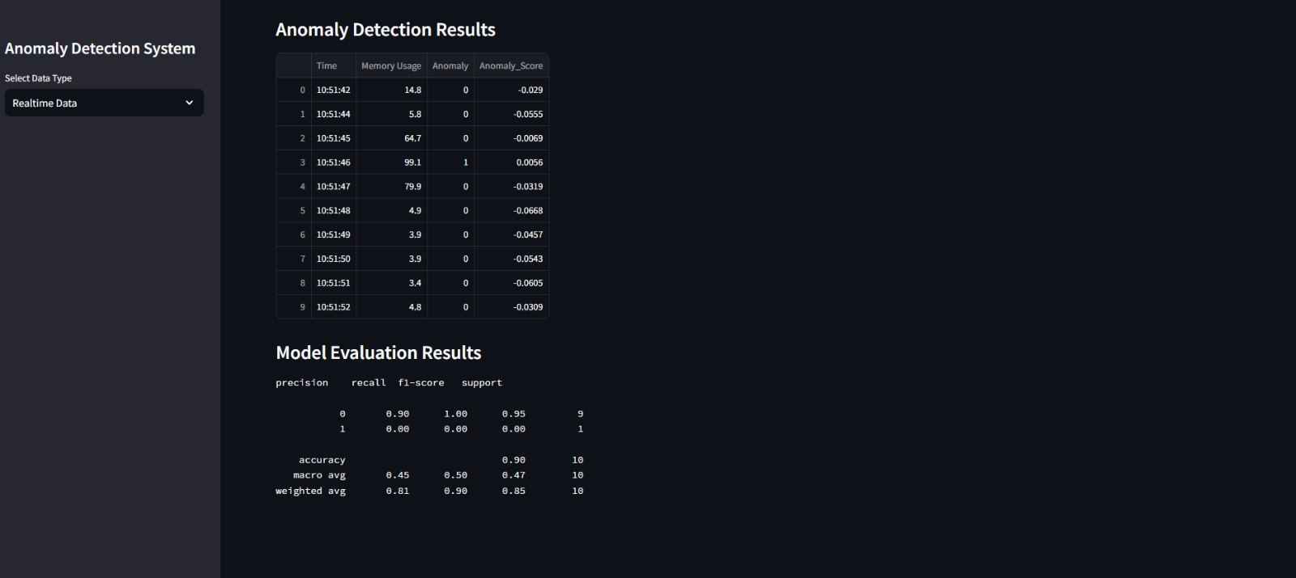
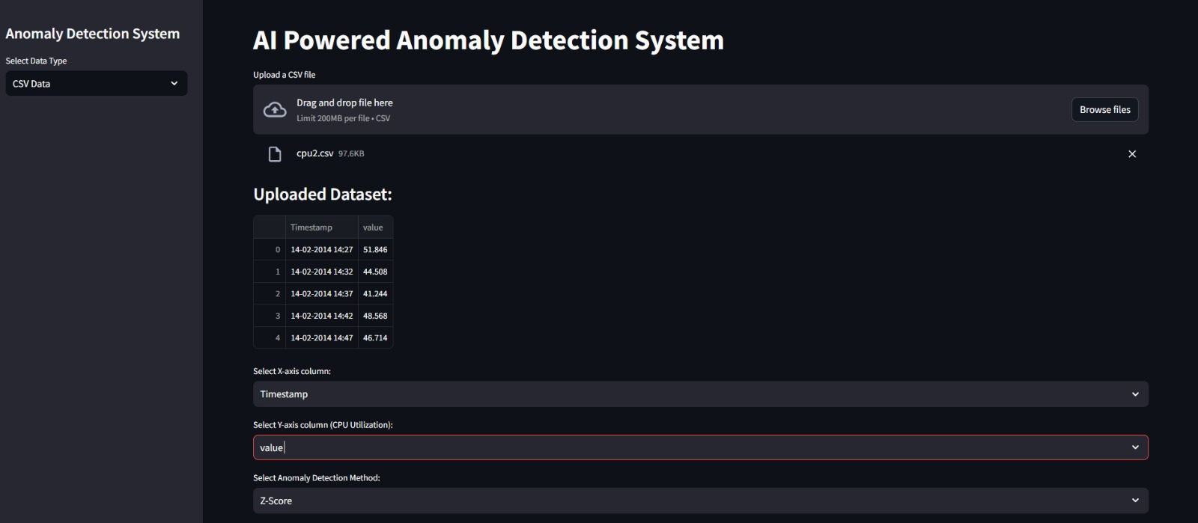
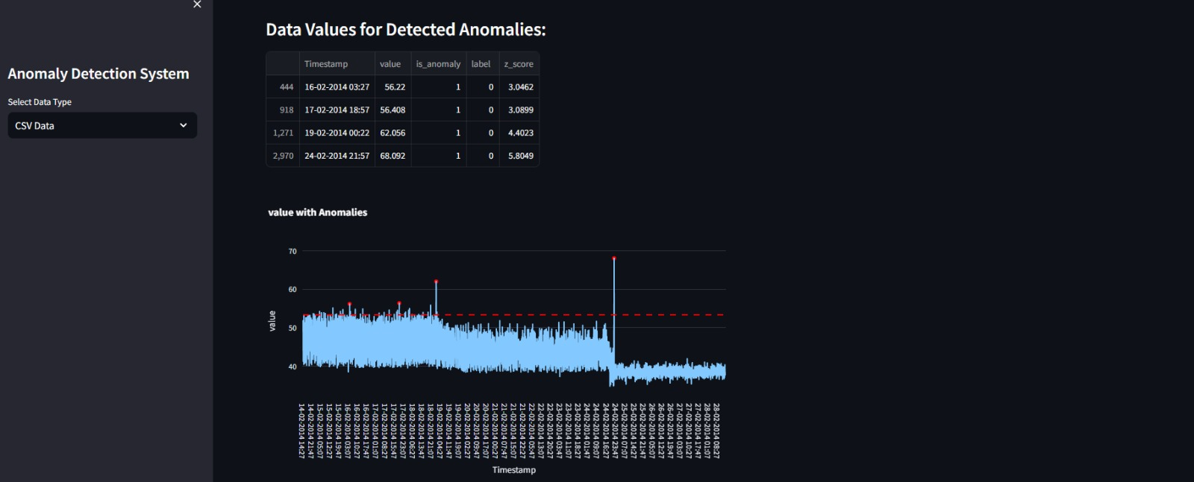
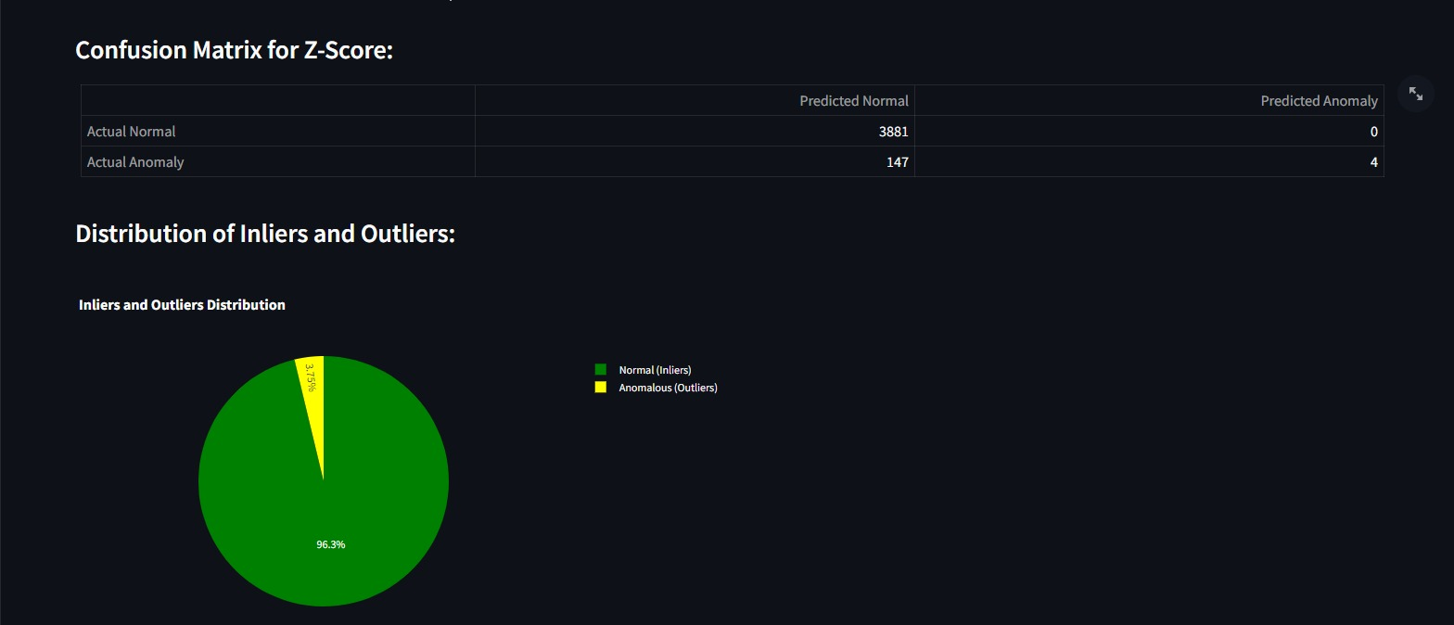
User Interface

Slide 9

Distinctive Features
Versatile Data Handling:
Format-independent.
Effortlessly managing real-time, CSV, and log data.
Transparency & Customization: Visualizations in the form of bar graph, pie chart and tables.
Universal Compatibility: Operates seamlessly across diverse systems and environments.
Open Source: All the frameworks, libraries and IDE are completely open source which makes it machine independent.

Slide 10
Solution Demo
https://drive.google.com/file/d/1_10DOcA3fWcnpRJMGJXU2zszmq2DK32-/view
To access the video, Please copy the link in browser or Ctrl + Click

Slide 11

Future Scope
Advanced Seasonality Prediction and Forecasting:
Enhance accuracy with AI/ML techniques.
Use ensemble methods and deep learning for robust forecasts.
Implement automated feature engineering and tuning.
Diverse Algorithmic Approaches:
Incorporate XGBoost, Random Forest, and advanced neural networks.
Explore hybrid models for adaptability.
Apply explainability techniques for insight.
Real-Time Data Processing with Message Brokers:
Integrate Apache Kafka for real-time processing.
Scale system for growing data volumes.
Implement monitoring and alerting for pipeline issues

Slide 12
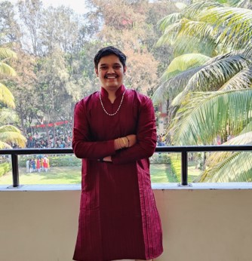


Team Photo
GOPALKRUSHNA KOLHE
RENUKA SARAF
ROHIT GADEKAR

Slide 13
Thank you

